Slide 1
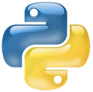
Top 5 Data Science Libraries
Python
Joe James
Math & Computer Science Tutorials
from Silicon Valley

Slide 2
1. NumPy
Used as a foundation for most other data science libraries.
Multidimensional arrays and matrices, and functions to perform all sorts of calculations on those arrays with minimal code.
Much faster performance than Python Lists because it uses contiguous memory blocks, and no need for loops.

Slide 3
2. Pandas
Provides flexible data structures that make working with relational or labeled data fast, easy and intuitive.
Performs math and statistical operations on time series data and DataFrames (matrices).

Slide 4
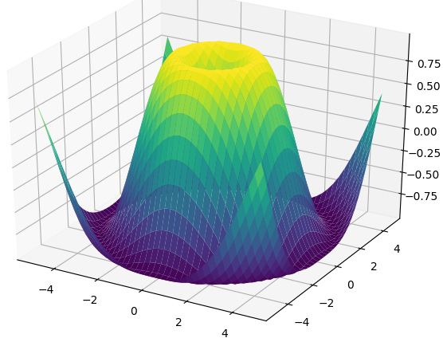
3. MatPlotLib
The ultimate data visualization tool.
Create every imaginable 2D or 3D plot, graph, chart, or map from your data with very few lines of code.

Slide 5
3. MatPlotLib
The ultimate data visualization tool.
Create every imaginable 2D or 3D plot, graph, chart, or map from your data with very few lines of code.
* See also: Bokeh for interactive visualization.

Slide 6
4. SciPy
Python’s top scientific library builds on NumPy with added features for analyzing and manipulating data.
Includes functions for numerical integration, optimization, and linear algebra.

Slide 7
5. Theano
Similar to NumPy, allows you to efficiently define, optimize, and evaluate mathematical expressions involving multi-dimensional arrays.
Exceptionally fast because it can leverage the GPU for computation.

Slide 8
Top 5 Python Data Science Libraries
NumPy
Pandas
MatPlotLib
SciPy
Theano

Slide 9
Top 5 Machine Learning Libraries
Python
Joe James
Math & Computer Science Tutorials
from Silicon Valley

Slide 10
1. TensorFlow
Google’s artificial neural networks library allows you to quickly set up, train and deploy multi-layered neural nets with large datasets.
It powers Google’s voice recognition and object identification from photos.

Slide 11
2. SciKit-Learn
Python’s machine learning module, built on top of NumPy and SciPy.
Performs clustering, classification, regression, and other ML functions.

Slide 12
3. Keras
User-friendly, high-level API for implementing neural networks.
Written in Python. Runs on TensorFlow or Theano backend.

Slide 13
4. NLTK
Python’s Natural Language Tool Kit.
Text processing libraries allow you to for classification, tokenization, stemming, tagging, parsing, and semantic reasoning.

Slide 14
5. XG Boost
An open-source software library which provides the gradient boosting framework for C++, Java, Python, R, and Julia.
Very popular on Kaggle.

Slide 15
Top 5 Python ML Libraries
TensorFlow
SciKit-Learn
Keras
NLTK
XG Boost

Slide 16

© 2017 Joe James

